Slide 1
Unified mentor internship project presentation
BY
ANIMESH DUTTA
POSITION : DATA ANALYST INTERN
INTERNSHIP ID : UMID01052533819
2 MONTHS INTERNSHIP
INTERNSHIP DURATION : 15/05/2025 -15/07/2025

Slide 2
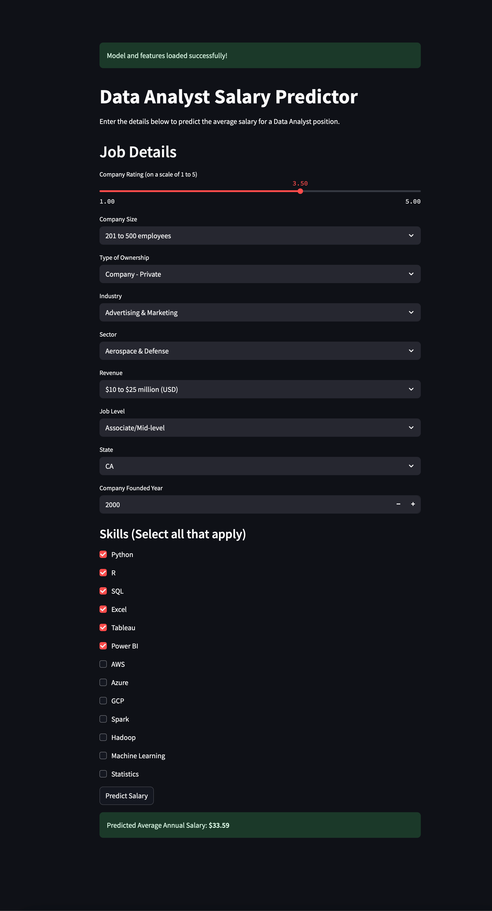
Data analyst jobs market analysis

Slide 3
contents
Introduction
Project objectives
Tools and technologies used
Methodology ( steps performed and outputs )
Data visualizations
conclusion

Slide 4
introduction
This project aims to analyse the Data Analyst job market using real-world job posting data.
it focuses on understanding various job attributes and their impact on salary estimates.
A machine learning model is developed to predict Data Analyst salaries, culminating in a deployable web application.

Slide 5
Project objectives
perform comprehensive data loading and data cleaning on the raw data analyst job dataset.
identify and analyse key factors that significantly influence Data Analyst salaries, such as industry, company size, and required skills.
uncover prevailing trends and patterns within the Data Analyst job market through exploratory data analysis.
provide an interactive tool for users to estimate Data Analyst salaries, aiding job seekers and recruiters.
build a robust machine learning model capable of predicting Data Analyst salaries based on diverse job characteristics.

Slide 6
Tools and technologies used
Programming Language: Python
Data Manipulation & Analysis:
Pandas
NumPy
Data Visualization:
Matplotlib
Seaborn

Slide 7
Tools and technologies used
Machine Learning:
Scikit-learn (for data preprocessing, model selection, training, and evaluation)
StandardScaler, MinMaxScaler
train_test_split
RandomForestRegressor, GradientBoostingRegressor
mean_absolute_error, mean_squared_error, r2_score
Model Persistence: Pickle (for saving/loading models)
Web Application Framework: Streamlit
Text Processing: re (regular expressions)

Slide 8
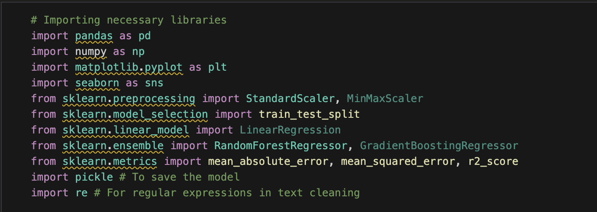
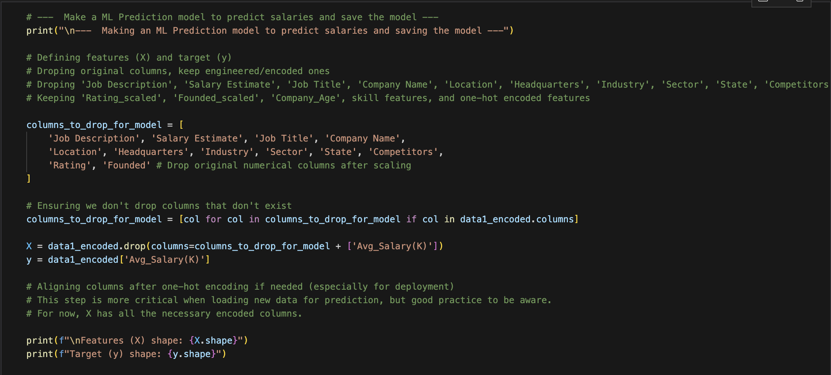
Snapshot of the framework used
IMPORTING LIBRARIES
THE PREDICTION MODEL MAKING USING FRAMEWORKS

Slide 9
METHODOLOGY
1. Data Collection & Initial Loading:
Loaded the DataAnalyst.csv dataset, containing various job attributes.
2. Data Cleaning & Preprocessing:
Handled missing values by replacing placeholders (-1, Unknown) with NaN and then dropping rows with missing 'Salary Estimate'.
Parsed 'Salary Estimate' strings to extract min_salary, max_salary, and Avg_Salary(K).
Cleaned 'Rating' and 'Company Name' columns for consistency.
Filled remaining categorical NaNs with 'Not Specified' and numerical 'Founded' NaNs with the median.

Slide 10
METHODOLOGY
3. Feature Engineering:
Extracted key skills (Python, SQL, Excel, R, Tableau, Power BI, AWS, Azure, GCP, Spark, Hadoop, Machine Learning, Statistics) from 'Job Description'.
Derived ‘Company_Age’ from 'Founded' year.
Categorized 'Job Title' into ‘Job_Level’(e.g., Junior, Senior, Lead).
Cleaned and standardized 'Industry', 'Sector', and 'State' information.
4. Exploratory Data Analysis (EDA):
Performed descriptive statistics to understand data distributions.
Analysed the distribution of 'Avg_Salary(K)'.
Investigated relationships between average salary and categorical features like Industry, Sector, Size, Type of Ownership, Job Level, and State.
Computed and visualized the correlation matrix of numerical features.

Slide 11
METHODOLOGY
5. Model Development & Evaluation:
Applied One-Hot Encoding to convert categorical features into a numerical format.
Scaled numerical features using StandardScaler.
Split the dataset into training and testing sets (80:20 ratio).
Trained a RandomForestRegressor model.
Evaluated model performance using Mean Absolute Error (MAE), Mean Squared Error (MSE), Root Mean Squared Error (RMSE), and R-squared (R2) score.
6. Model Deployment:
The trained model and feature columns were saved using Python's pickle library.
A user-friendly web application was built with Streamlit to enable interactive salary predictions.

Slide 12
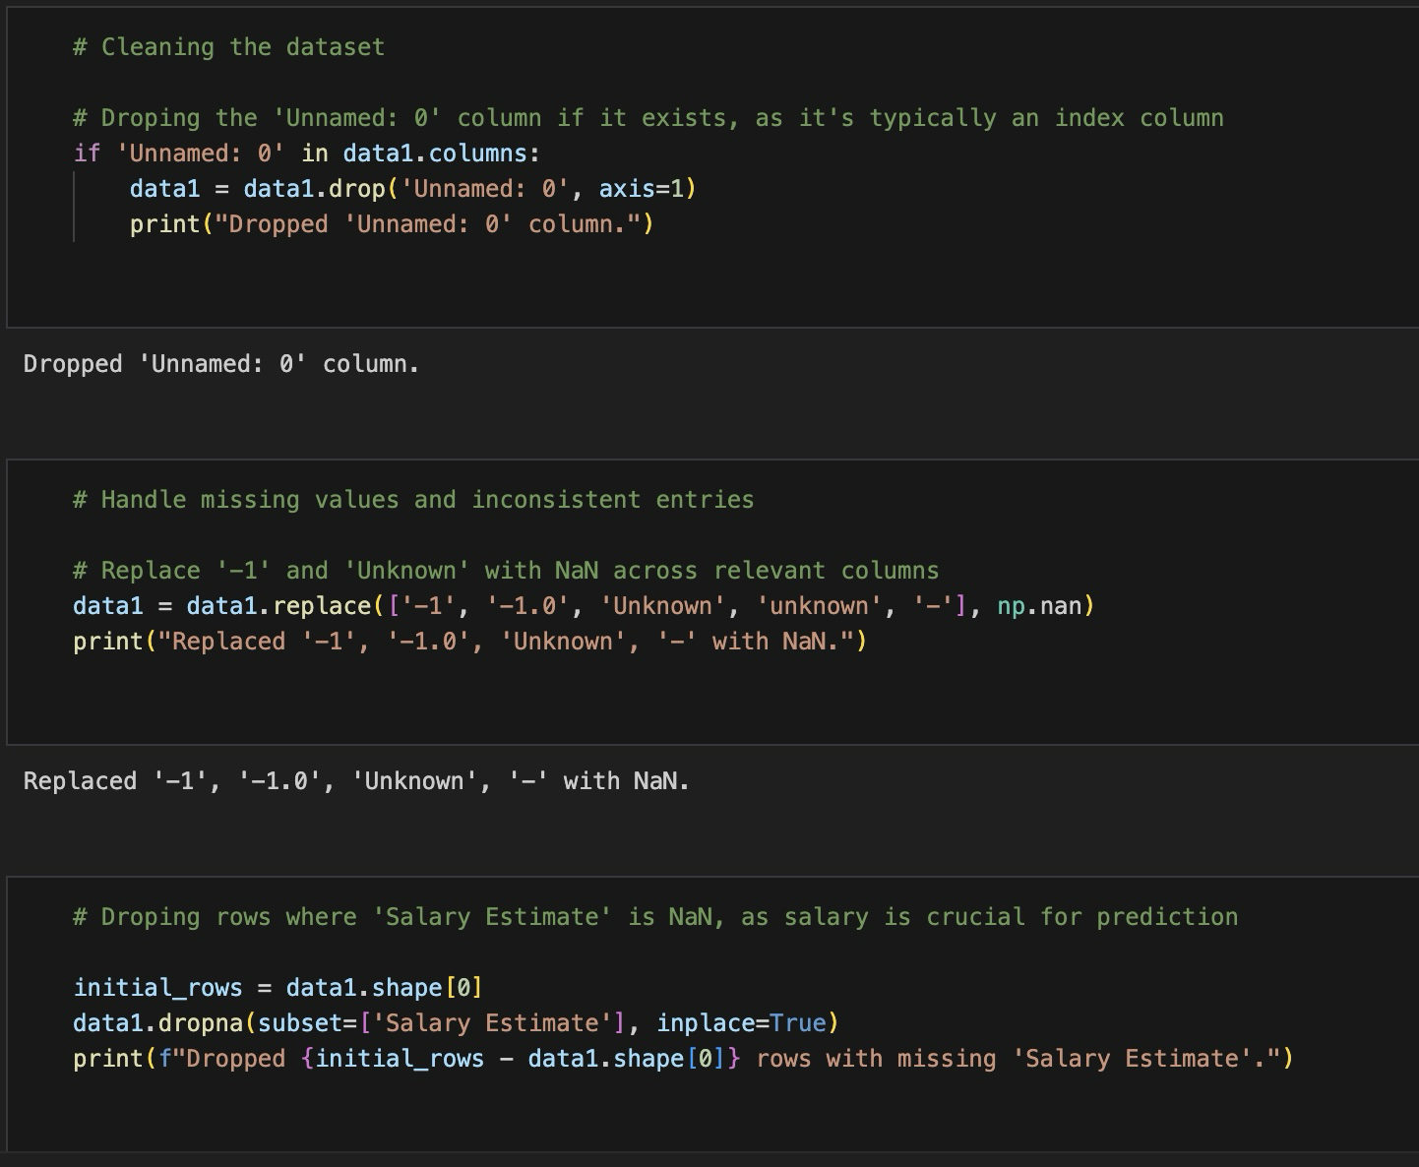
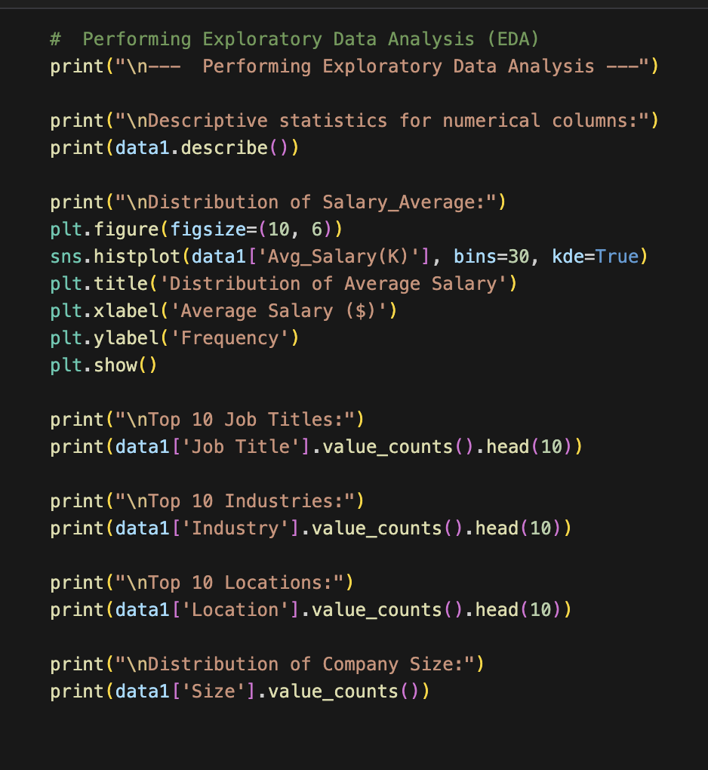
Code snapshots
DATASET CLEANING
PERFORMING EXPLORATORY DATA ANALYSIS

Slide 13
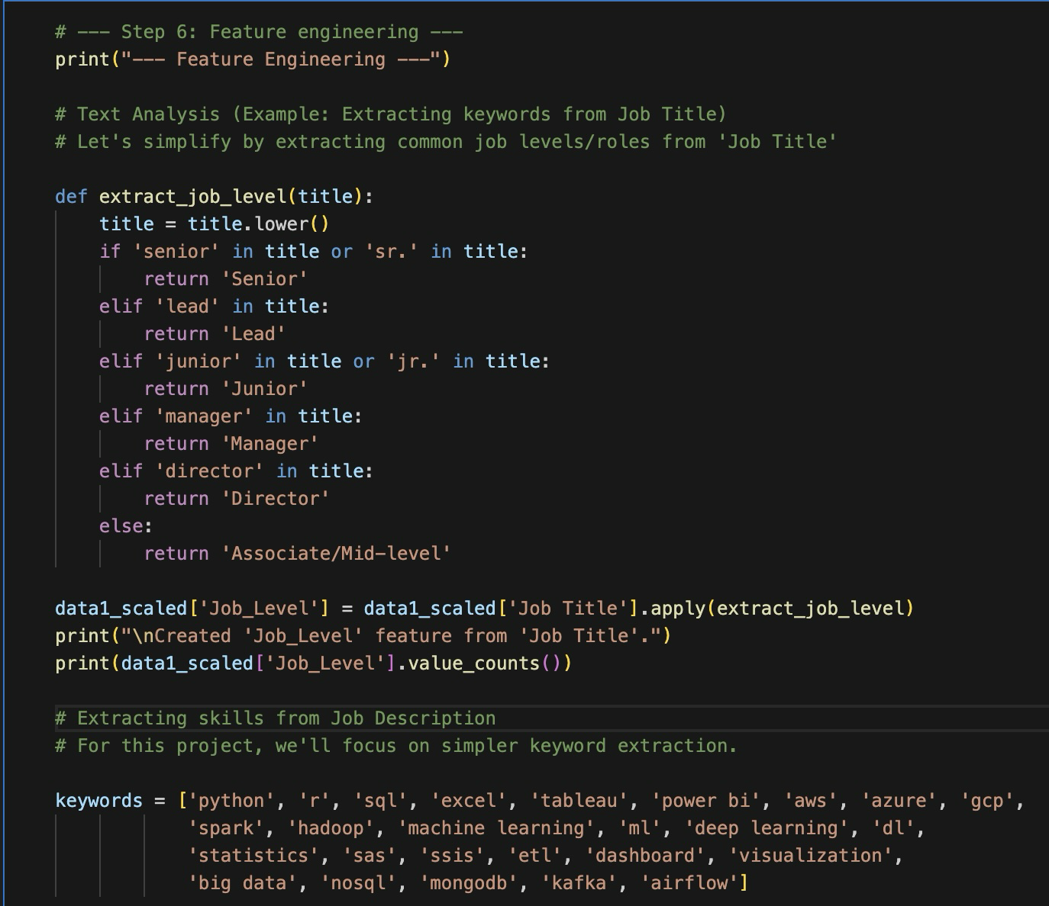
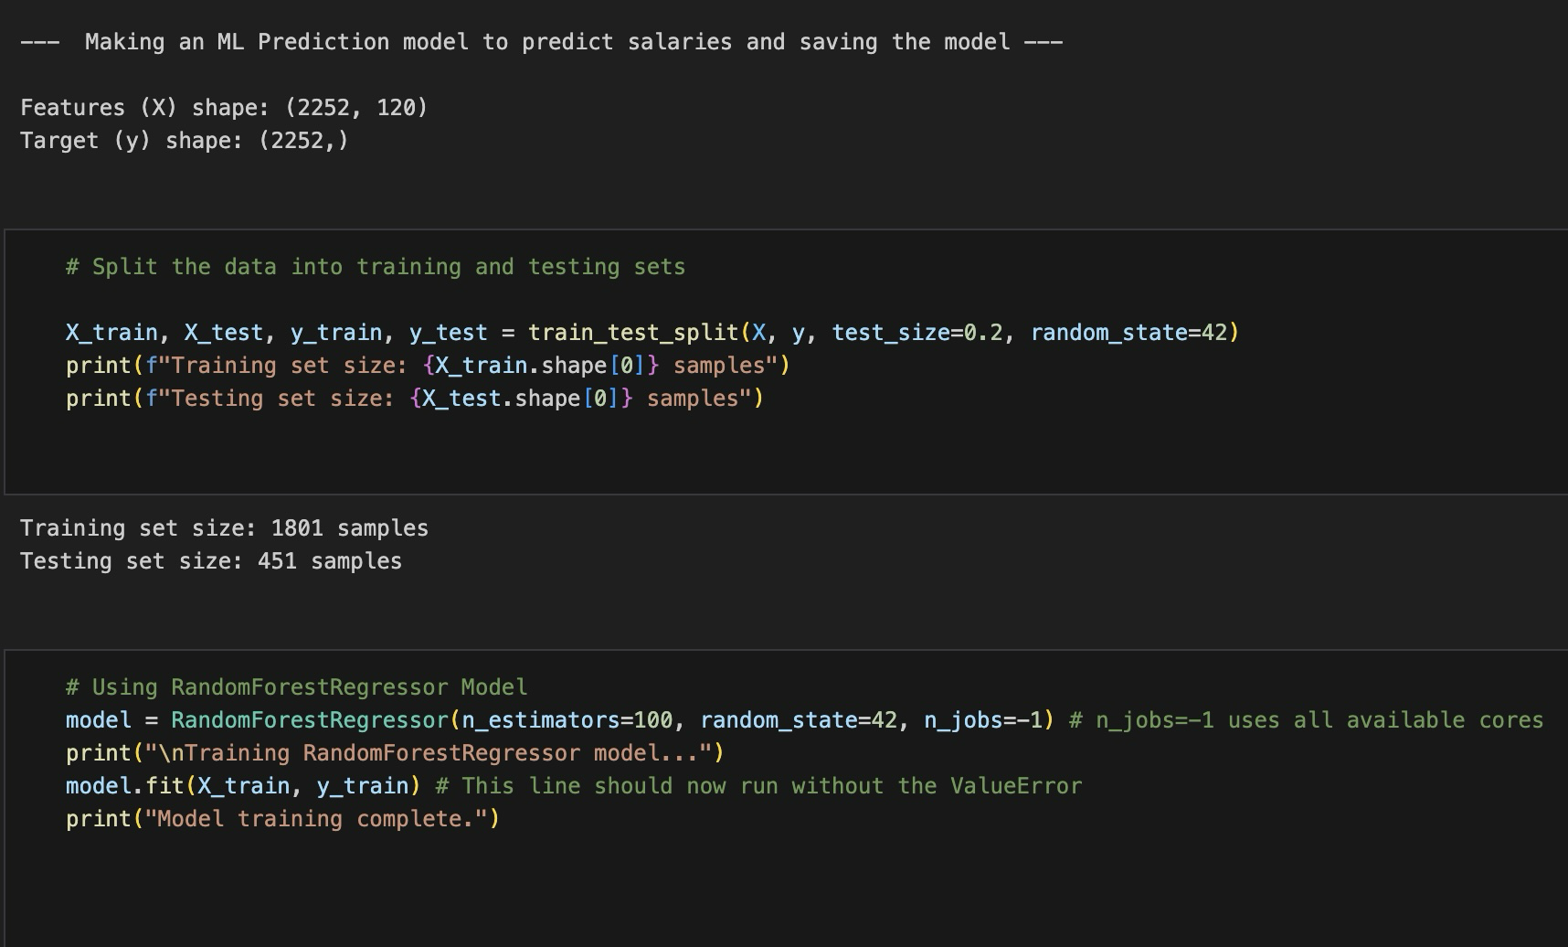
Code snapshots
PERFORMING MODEL TRAINING
FEATURE ENGINEERING

Slide 14
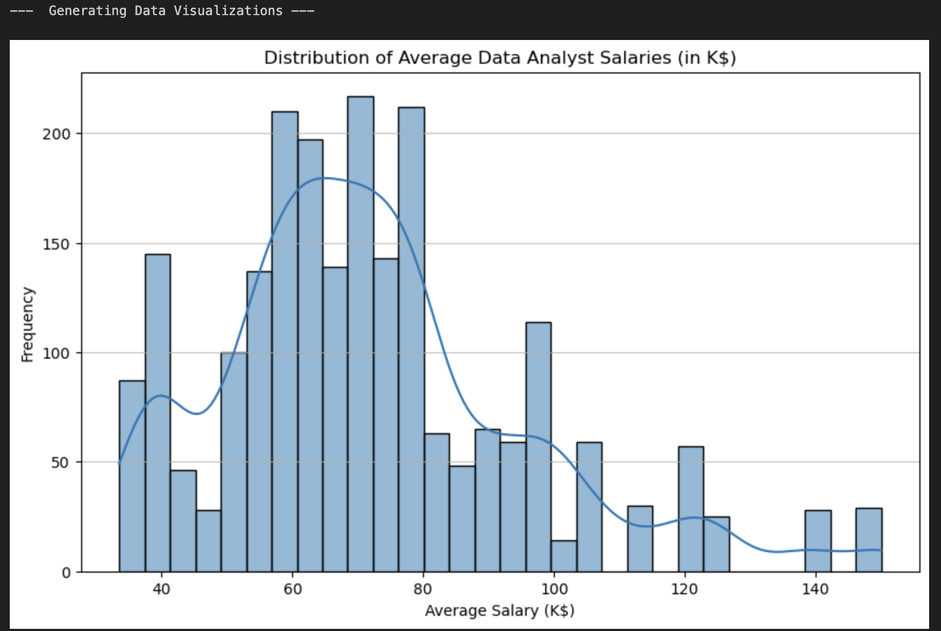
Data visualization
Distribution of average data analyst salaries
This histogram shows the average salary distributions, Average salary vs frequency chart

Slide 15
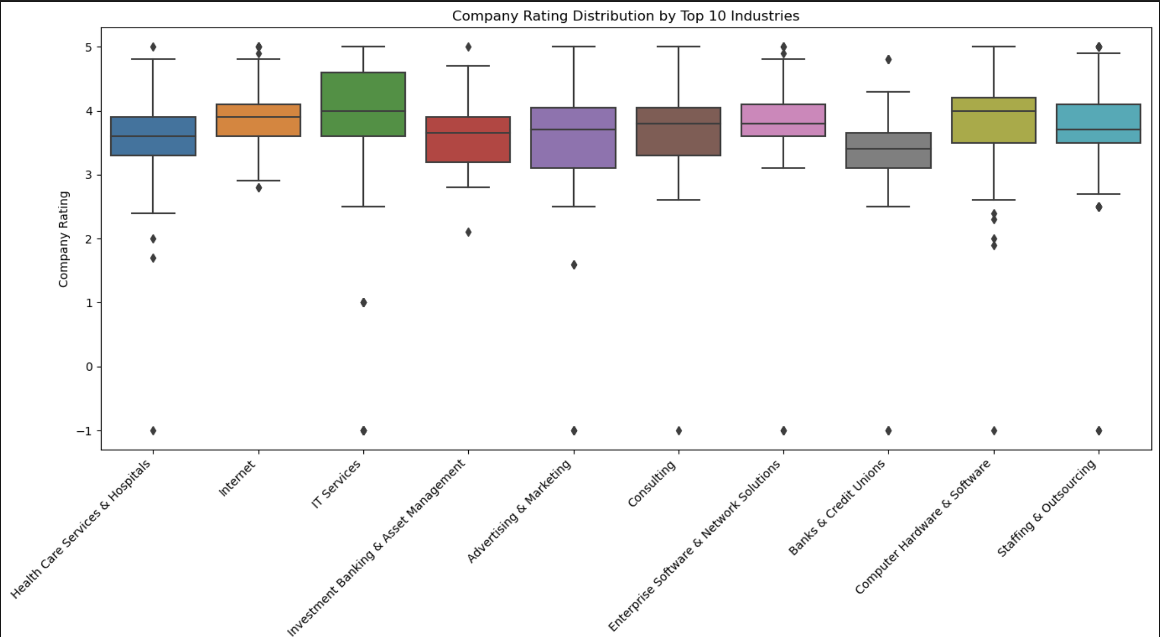
Data visualization
Company rating distribution by top 10 industry
This boxplot shows the top 10 industries by company rating

Slide 16
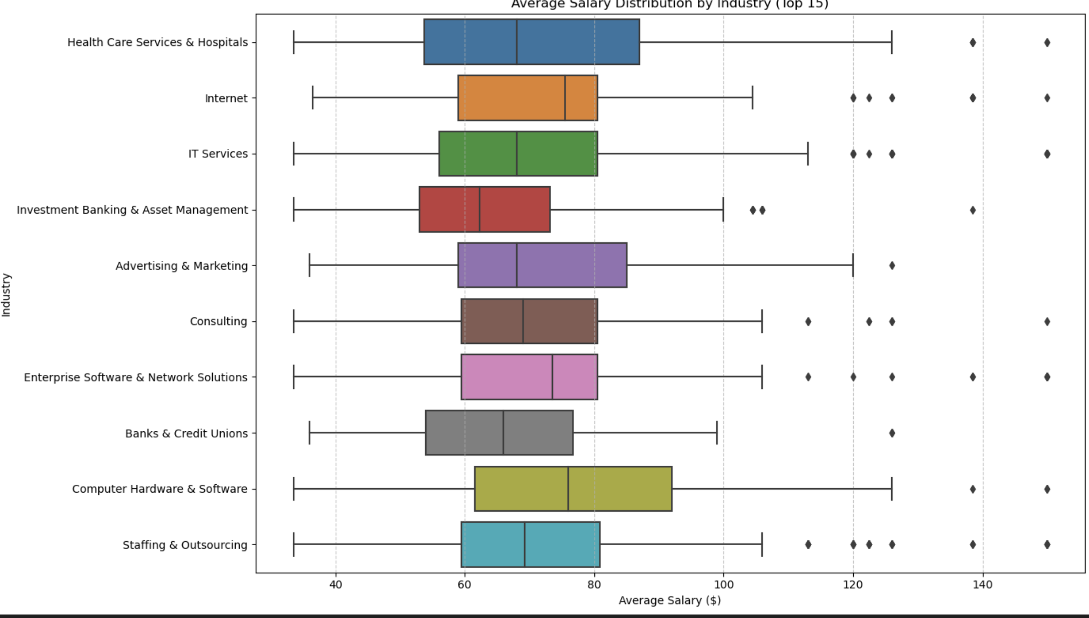
Data visualization
Salary distribution by industry
This boxplot shows average salary distribution by industry

Slide 17
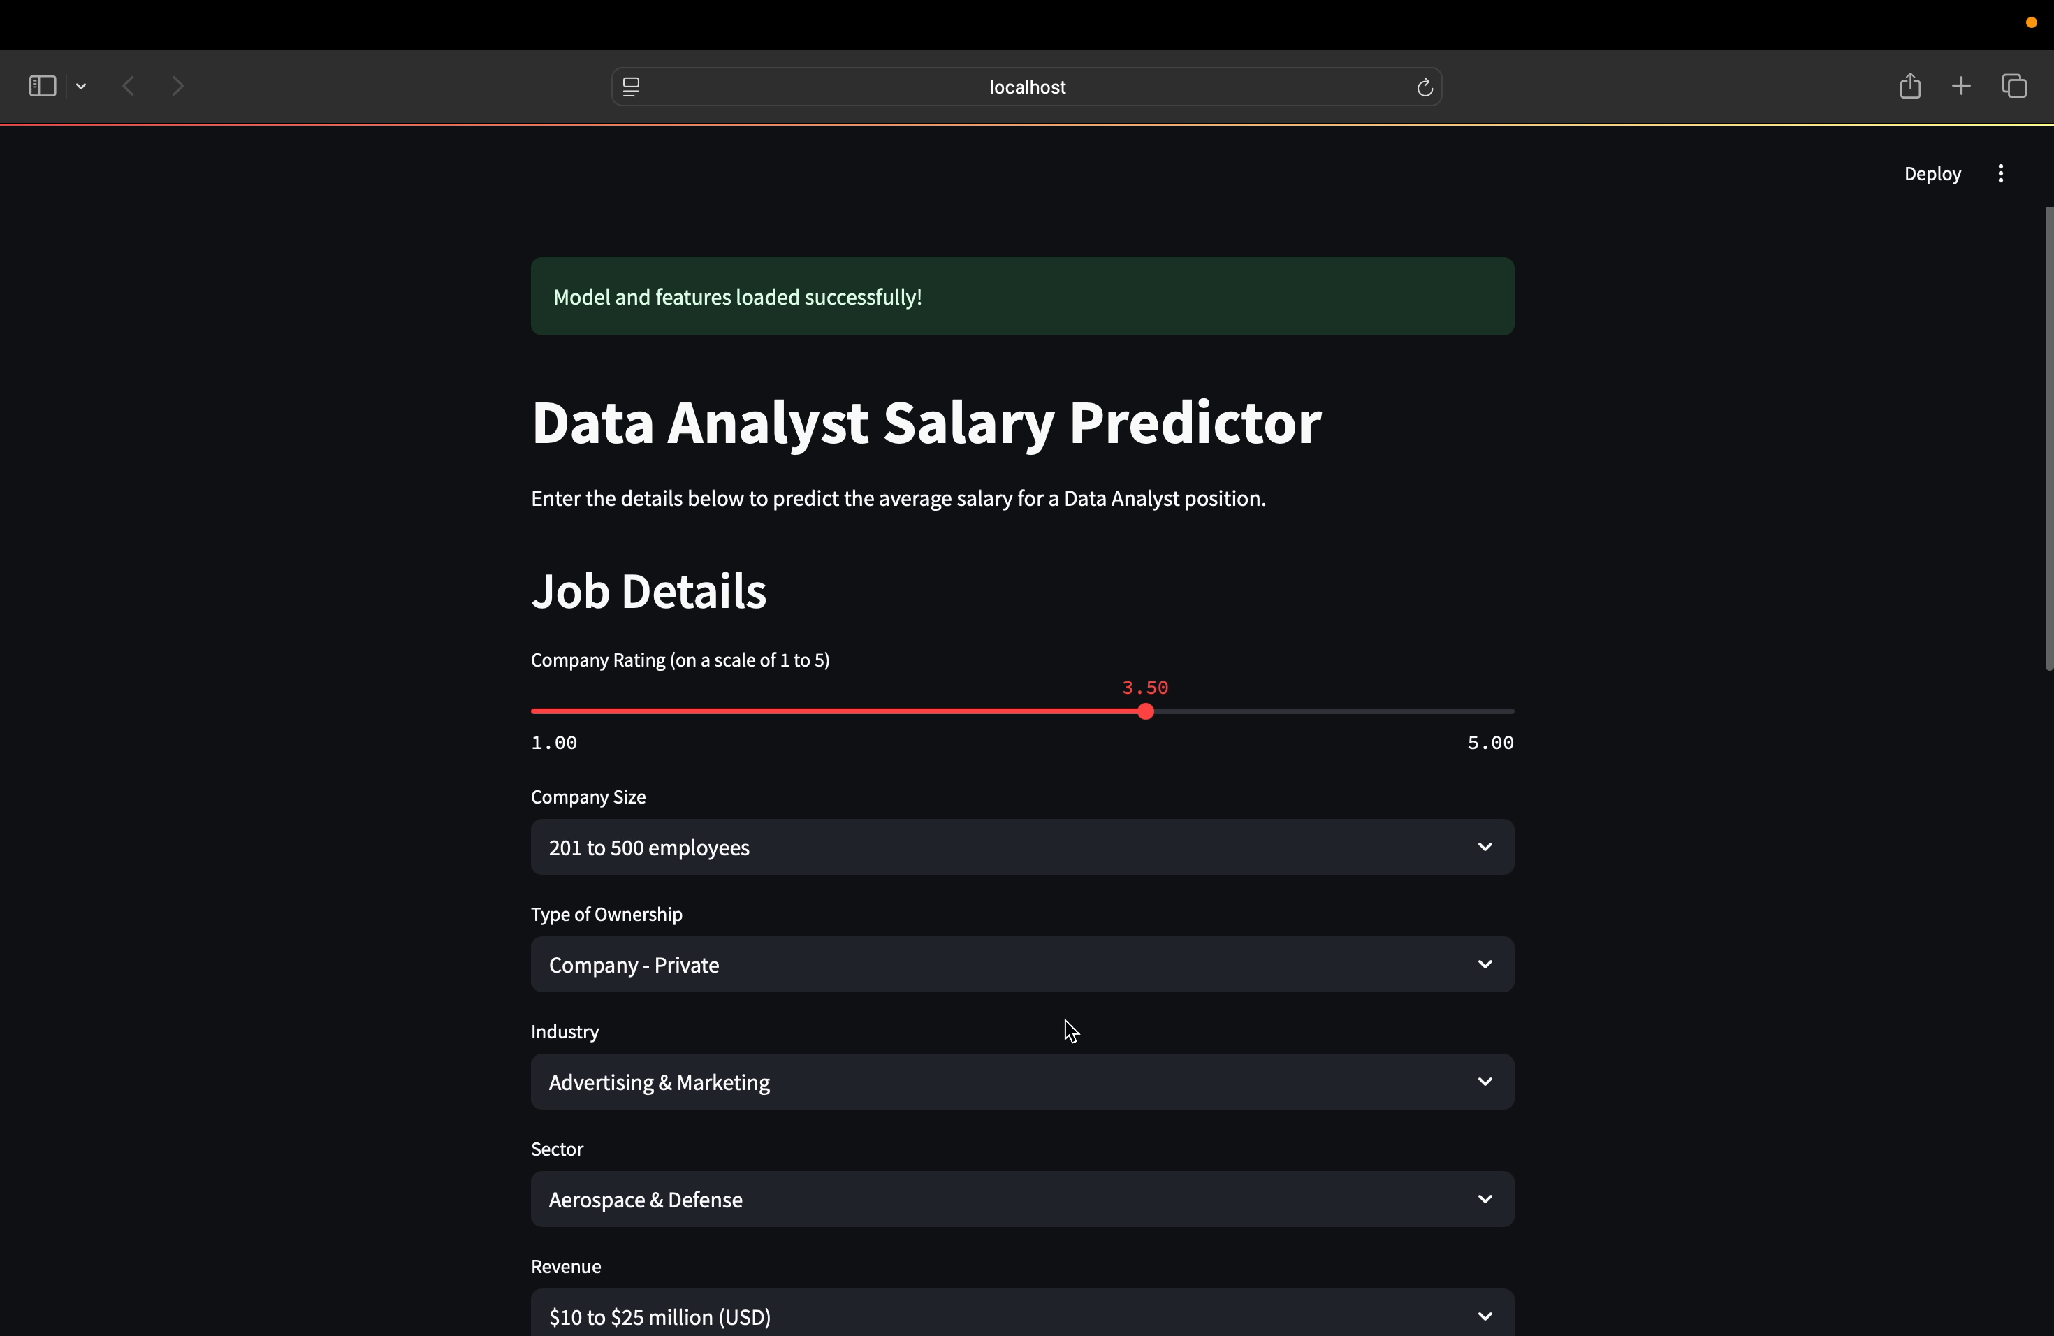
Data visualization
Prediction model
Stream lit based web application that will predict data analyst salaries based on matrices.

Slide 18
conclusion
We looked closely at a lot of Data Analyst job postings to find out what's important in the job market, like common skills or company types.
We made a computer program that's quite good at predicting how much a Data Analyst might earn. It's about 70% accurate (that's what our R2 score of 0.6975 tells us).
We turned our salary guesser into a simple website, so anyone can easily input details and get a salary prediction.

Slide 19
The thankyou note
I am truly grateful towards unified mentor for giving me this wonderful opportunity to work as a data analyst intern for this past 2 months, I have learned about many concepts that will be essential for my data analyst journey in coming future. The detailed and full projects of mine will be provided in the git hub link below.
Project : data analyst job analysis

Slide 20
thankyou

